Slide 1
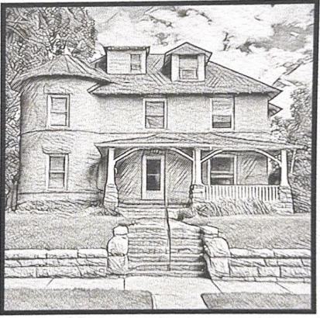
Promise Ridge
A Shelter for Women with Children
experiencing a housing crisis

Slide 2
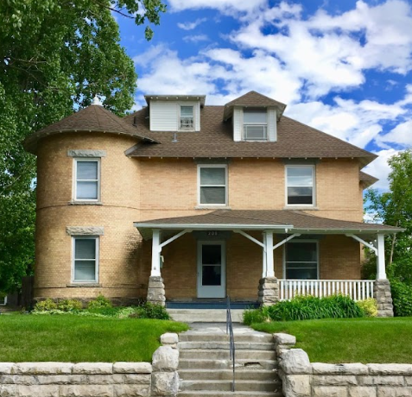
Promise Ridge is a housing shelter for women and children located in the historic Minnie Hitt Home in Idaho Falls. Minnie Hitt made a name for herself in the banking industry in the early days of Idaho Falls. She was a prominent, well-respected figure in the community, known for her intelligence and generosity. We are proud to be the steward of this beautiful, historic home.
Notes:
Built in 1903

Slide 3
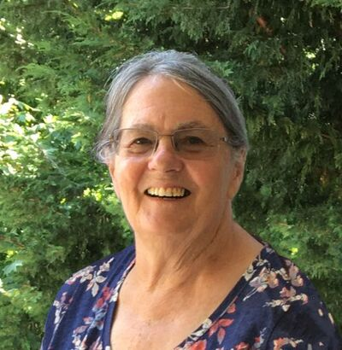
The Vision began in 2018 with Peggy Sharp
“Peggy saw Promise Ridge as part of the puzzle to combat the homelessness in Idaho Falls for families. She understood that the problem of homelessness is complicated and messy. It is the result of generational poverty, mental illness, substance abuse, and so much more. At St. Vincent dePaul she saw children living in cars or couch surfing and wanted to provide a safe place for them besides just a hotel room for a night. Promise Ridge is that place of shelter from the storm.
Promise Ridge is a short-term reprieve from the stress of living without basic necessities.”
Liz Marsden, daughter of Peggy Sharp
Notes:
Peggy passed away unexpectedly in 2022.

Slide 4
Our Work
In 2018, Promise Ridge opened its doors to women with children who are experiencing crisis leading to homelessness. We can house 5 families at a time in a family focused atmosphere.
Families share common meal areas, work together to care for the home, and develop positive relationships and skills by living in a community. Our staff works with our guests to set and work toward long term housing goals and assist them with finding resources to move forward.
It is our hope that women entering our shelter will transition to permanent housing within 60-90 days.
Notes:
In 2023, we housed 24 families which included 46 children for a total of 1,101 nights of safe housing. Thirteen of those families were successful in finding permanent housing with the support of Promise Ridge. So far in 2024, We have housed twelve women and thirty children with an average stay of 116 days. This is higher than our target due to housing availability challenges in our community. Of the twelve guests we served so far this year, nine have moved into their own housing after leaving our shelter with another three poised to do so within three weeks.

Slide 5
Our Supporters and Fundraisers
Hundreds of Individual donors throughout Idaho Falls and beyond
December 9-31, 2024 April 28 - May 1, 2025

Slide 6
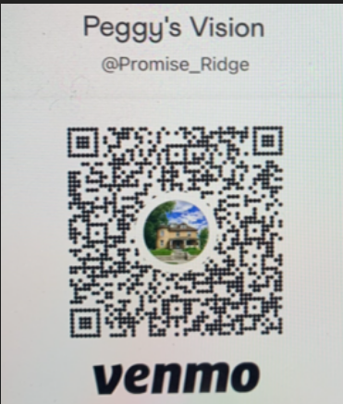
Promise Ridge is committed to providing safe, family focused housing for our guests while maintaining the integrity of this beautiful home. We appreciate your support in keeping with these goals.
Venmo@ Promise_Ridge
Cost to support Promise Ridge Shelter for one day: $375
Cost to support one family
for a day: $75 for one week: $525
Notes:
(Promise Ridge daily support is based on annual expenses divided into daily units. Family support is based on 5 room occupancy.)

